Slide 1

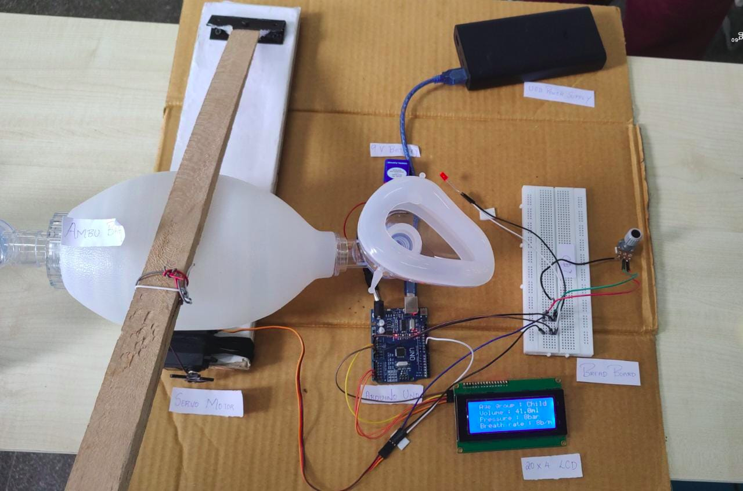







Innovative Projects- Arduino Using Embedded ‘C’ (CSE1002)
IOT BASED VENTILATION SYSTEM
IPA – (392)
26TH – 27TH
MAY 2023
IoT-based Ventilation system using Arduino is a low-cost, respiratory monitoring, and controlling system. The designed and developed ventilator delivers breaths by compressing a conventional Ambu bag with the help of a fixed arm connected to a servo motor. It eliminates the need for a human operator for the bag valve mask.
Ms.Sudha Y (Assistant professor)
Department of Computer science and Engineering
MAHINDRA L SHETTY
20221CAI0126
GOUSE E ZAMA
20221ECE0069
VARUN
20221CSD0096
SANGEETHA E
20221CAI0132
DEEPAK R
20221CAI0144
MONISHA M
20221CSG0135

